Slide 1

By M. Mary Margarette
Class and Objects

Slide 2
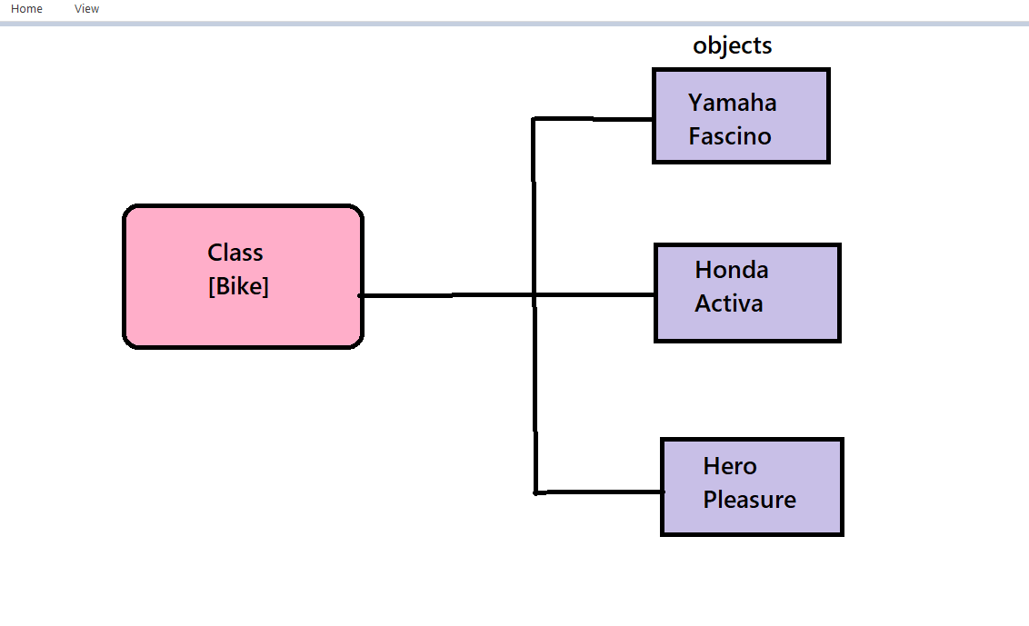
Pictorial Representation

Slide 3
Bike is a class which calls objects(Yamaha).
Yamaha gives the method of Fascino.
Fascino is the method gives functioning of bike with variable declaration.
Bike - class name
Yamaha - field
Fascino - method

Slide 4

Thank You

